Slide 1
Human Operated Ransomware
...

Slide 2

Who is this guy?
Currently:
Proud Pet Parent!!!
Family's personal-Tech
I'm a recovering Admin; I hope to pass on knowledge that wasn't passed to me.
Education:
Master of Science, Cybersecurity & Info Assurance
50+ Industry Certifications
https://www.linkedin.com/in/jessefmoore/
Notes:
Stories/Reasons: I am A..., Who Helps..., Because...
Email everyone you know letting them know you would never ask for gift cards or wire transfers
Security is my after work hobby, so I am passionate about it.

Slide 3
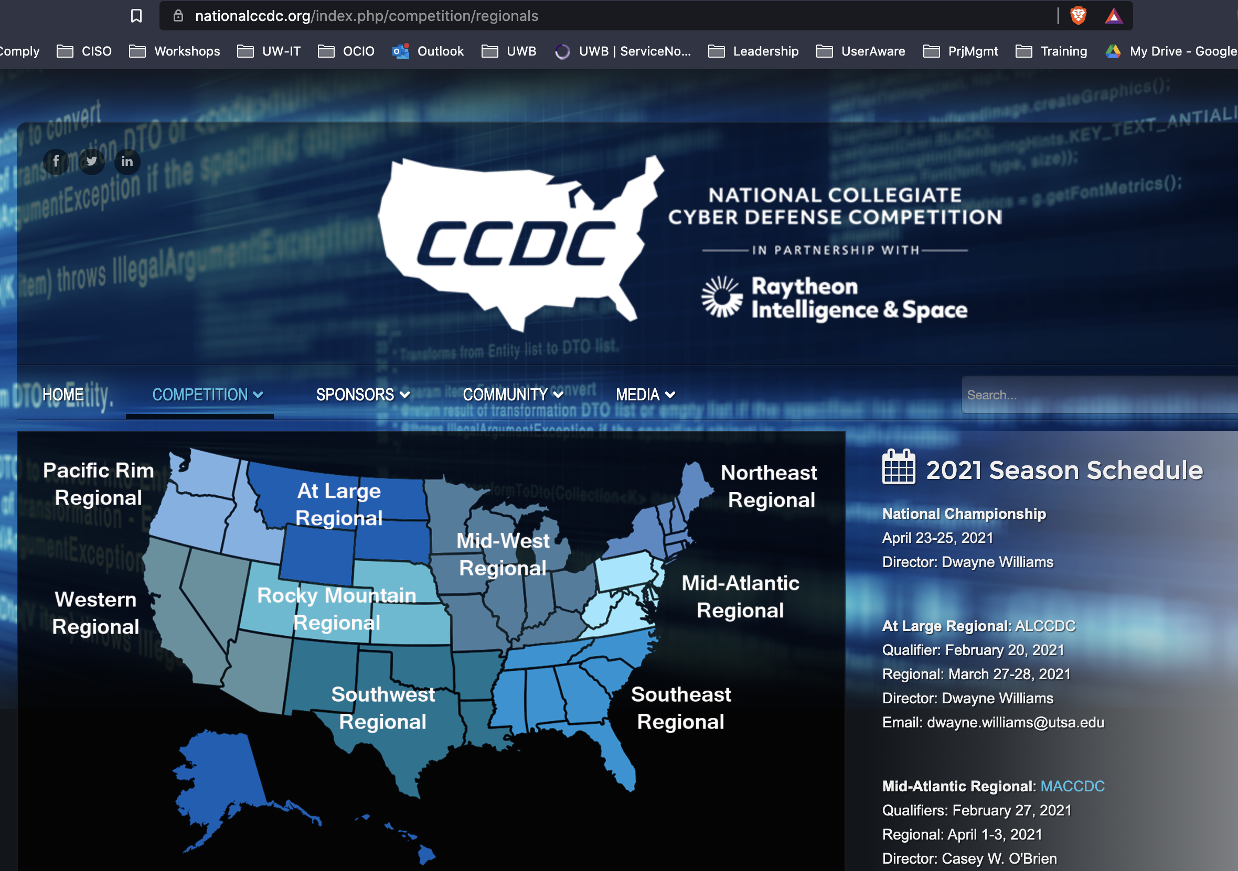
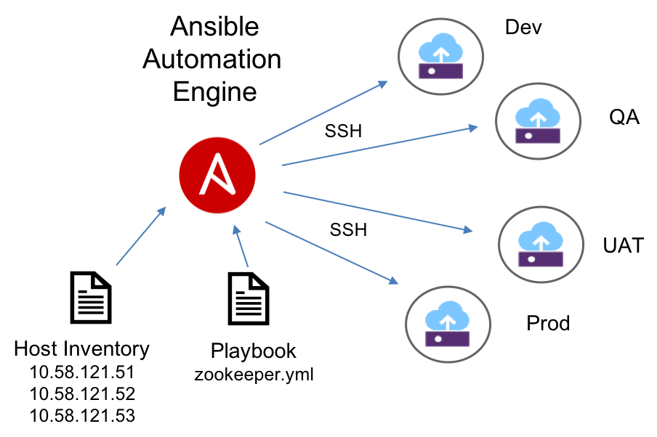

What has Jesse Been up to?
Since we last met…
I’ve been working on building infrastructure for WRCCDC.
Using Ansible to automate deployments within vSphere
Notes:
Build out entire business systems for competition, I can relate to sysadmin frustrations on keeping things operational.

Slide 4
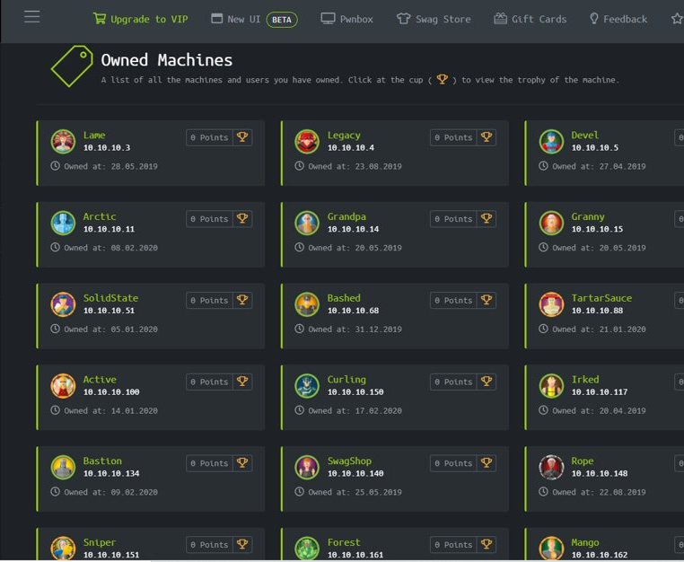
And in my spare time I Hack The Box!
Notes:
Call out swagshop

Slide 5
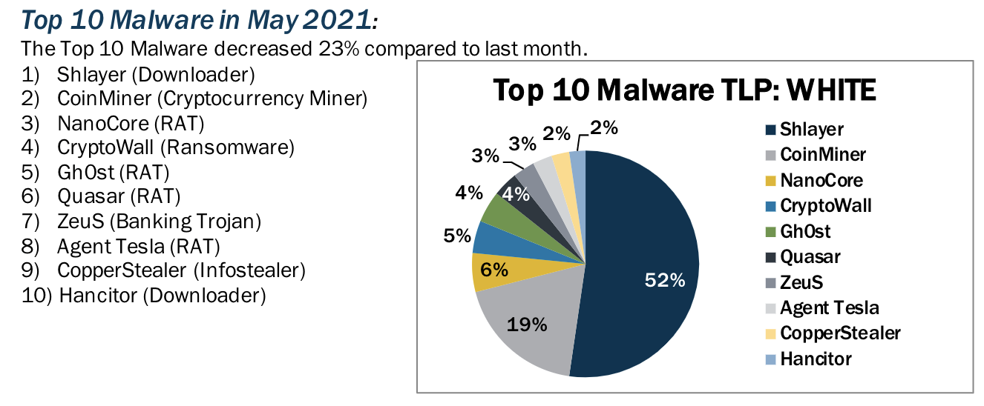
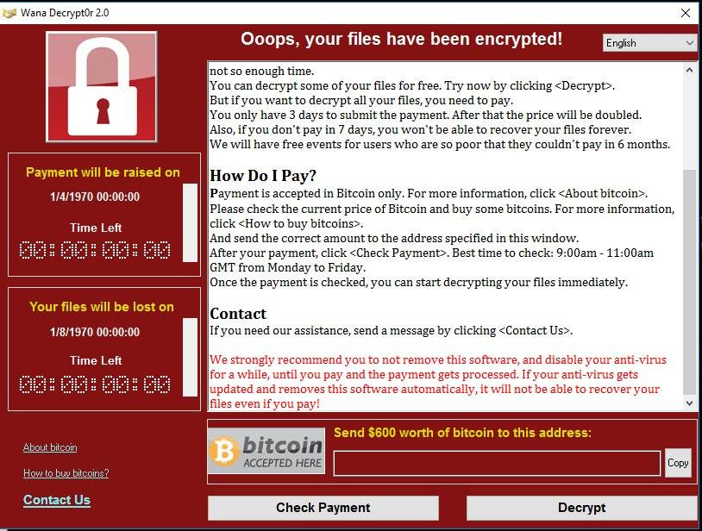
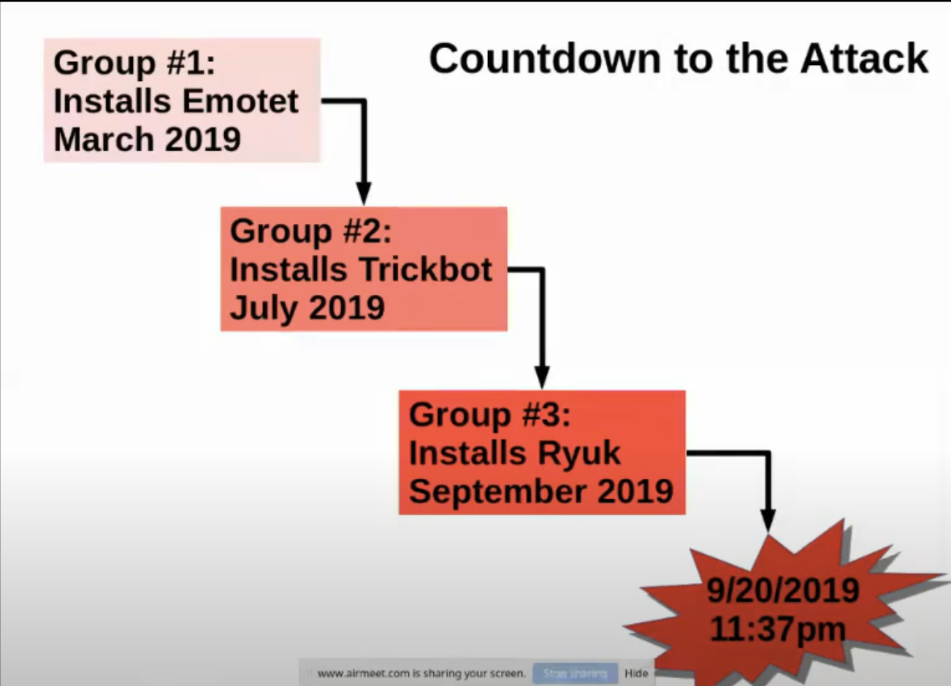
What is this Human Ransomware?
Humans that manually exploit (something) to access systems.
Normally we focus on Ransomware message OR Human for that matter.
what about all the steps while they are in?
Northshore School district System admins share their experience:
https://www.youtube.com/watch?v=HwfRxjV2wok
Notes:
https://attack.mitre.org/groups/
Jessice from Micrsoft (IR at the time):
https://twitter.com/jepaynemsft/status/1255991971845308416

Slide 6






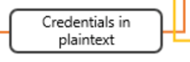


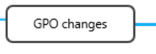

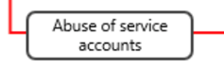
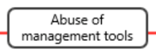
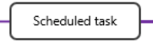

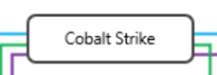

Steps to move thru your machine
Source: https://www.microsoft.com/security/blog/2020/04/28/ransomware-groups-continue-to-target-healthcare-critical-services-heres-how-to-reduce-risk/
Notes:
RDP brute force is trying to reuse passwords... HAVEIBEENPWNED
Vuln on Internet –see it with Shodan or nmap or other free tools to find CVEs and easily exploit.
Weak application settings... Patch, secure configs, GPO settings, firewall, segmentaion, logging, etc

Slide 7
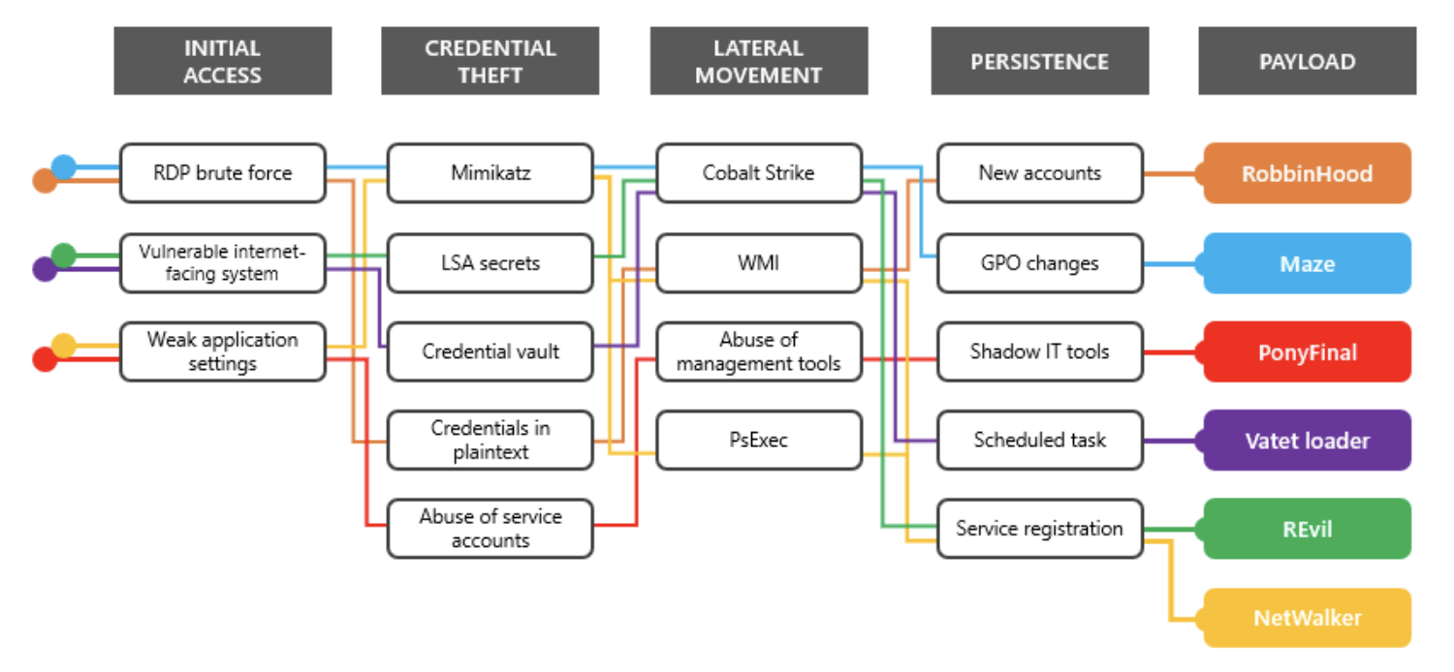
Attack Chain
Notes:
https://www.microsoft.com/security/blog/2020/04/28/ransomware-groups-continue-to-target-healthcare-critical-services-heres-how-to-reduce-risk/

Slide 8
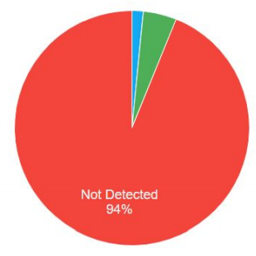

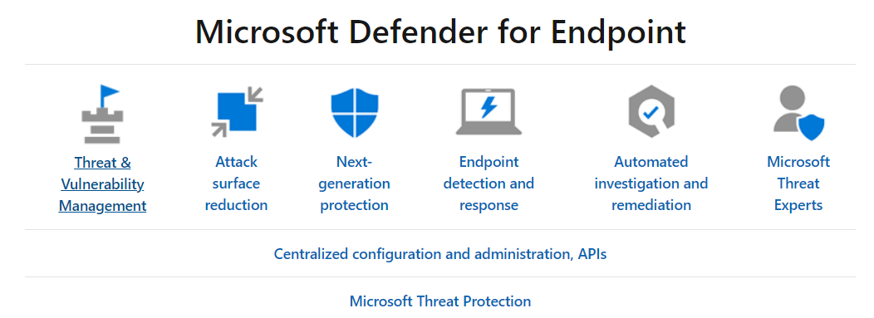
What could be done? Detection!
Use MSFT Sysmon for MSFT Windows!
ATP for MSFT Defender for Endpoint
Windows Sysinternals - Windows Sysinternals | Microsoft Docs
Microsoft Defender for Endpoint - Windows security | Microsoft Docs

Slide 9
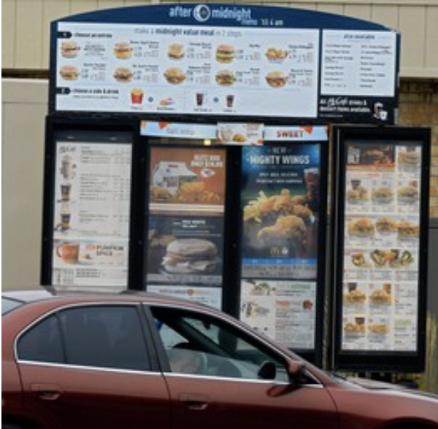
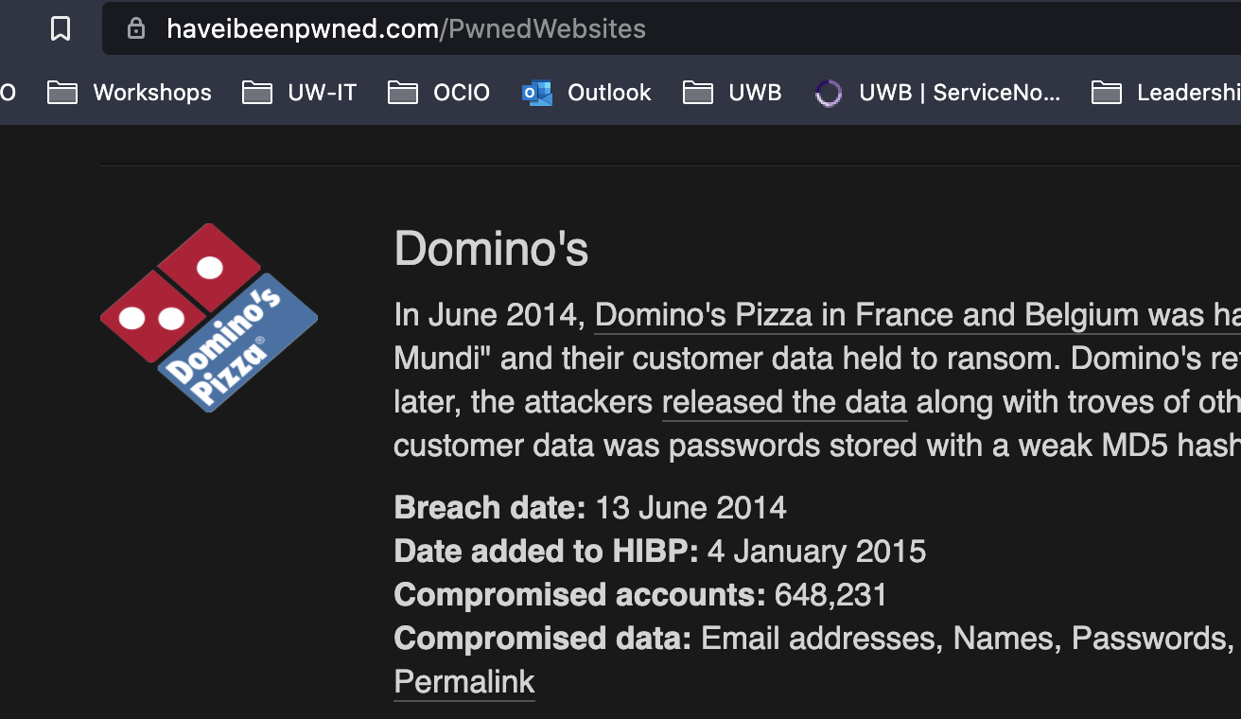
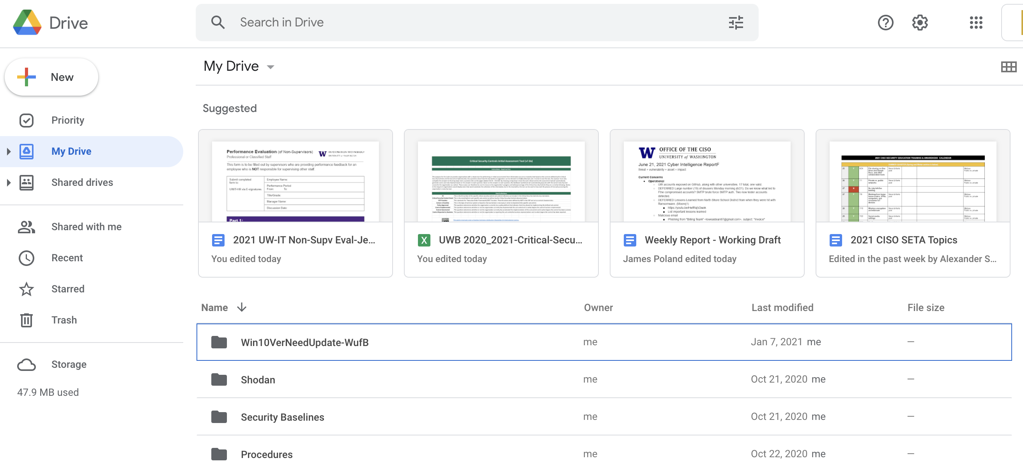
Steps in attack (as simple as 1,2,3-4.)
1. Research/Look for : systems on Public Internet or website for email addresses for Phishing, etc
2. Initial access: could be from reuse passwords get in.
https://haveibeenpwned.com/Passwords
3. Search for important Data. (email?)
4. Take data out from computer.
Aka Download it and then 7-Zip it!
Notes:
https://attack.mitre.org/
Image: SRC: https://www.pentestpartners.com/security-blog/data-exfiltration-techniques/
Shodan Report or find Phish email: Faculty | UW Biology (washington.edu)
CrackMap2User2AdminPsexec (screencast-o-matic.com)
Crackmapexec Pass the Hash
CrackMap2User2AdminPsexec (screencast-o-matic.com)
EXFIL -T1560.001.md
Have I Been Pwned: Check if your email has been compromised in a data breach

Slide 10
DEMO Time
Lets emulate it 4realz
Red Team Atomic Tests (test your detections)
Notes:
Emulate is going to Mitre and using those tactics techniques
Simulate is trying to get around your detections.
https://github.com/redcanaryco/atomic-red-team/blob/471d30b4f348a039c507bc0f9e823b037ac643ac/atomics/T1560.001/T1560.001.md
Atomic Test - Compress Data and lock with password for Exfiltration with 7zip T1560.001
Atomic Test #2 - crackmapexec Pass the Hash T1550.002
https://github.com/redcanaryco/atomic-red-team/tree/8eb52117b748d378325f7719554a896e37bccec7/atomics/T1550.002
Search Data when on box:
Atomic Test #1 - Email Collection with PowerShell Get-Inbox
https://github.com/redcanaryco/atomic-red-team/blob/8eb52117b748d378325f7719554a896e37bccec7/atomics/T1114.001/T1114.001.md
T1003.003 NTDS
Maybe show PRCCDC
PRCCDC-Wiki/jerrichov4.ps1 at master · bluscreenofjeff/PRCCDC-Wiki (github.com)

Slide 11




Thank you!
Email CISO@uw.edu and add in the Subject line: "detecting bad things on Windows 10 Workshop"
Winter2021#!
Notes:
Are you sure your detections are detecting? What happens once intruders are in your network?
Baseline your business processes and know how your computers work and work with other computers.

